Slide 1
Emerging Research: Measles
Chrishey Holbrook & Haritha Aji
SAT 5424

Slide 2
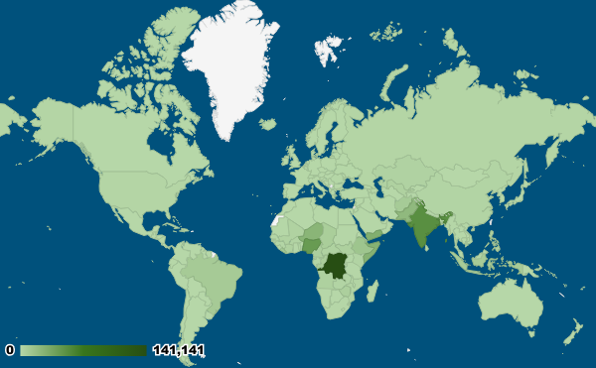
Introduction
Measles, also known as rubeola.
Measles is one of the most contagious infectious diseases, and also one of the most preventable.
2022 saw increase of 18% to 9 million cases
& increase of 43% to 136,000 deaths.
WHO news release Global measles threat continues to grow as another year passes with millions of children unvaccinated

Slide 3

Measles Overview
Fever
Higher risk in children who don't get vaccines on schedule.
Children under age 5 who are at highest risk.
Complications including pneumonia, encephalitis (brain swelling) and death.
Runny nose
Sneezing
Cough
Rash
“
“
two doses of vaccine in childhood is 97% protective
NPR report: It's no surprise there's a global measles outbreak. But the numbers are 'staggering'

Slide 4
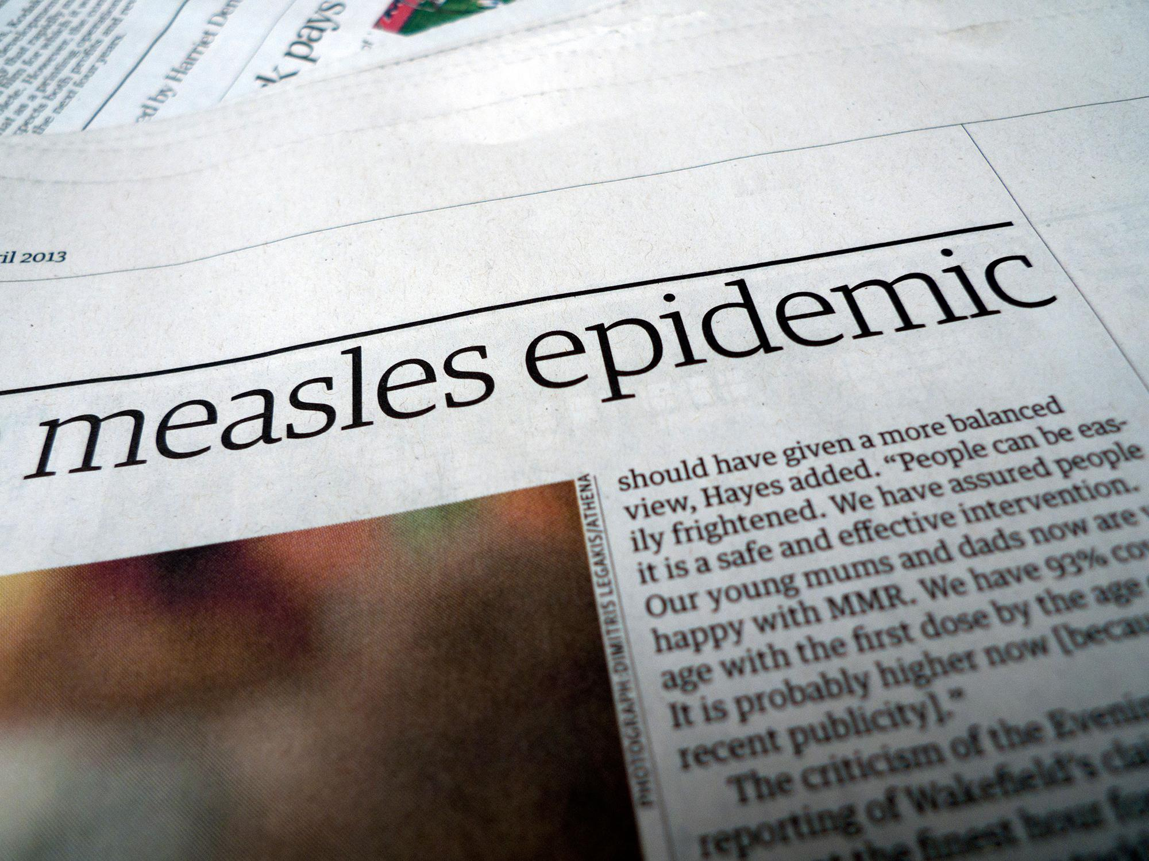
Recent Measles Outbreaks
2022 vaccination rates are lowest since 2008 at 83%. As a result of high vaccination rates, measles hasn’t been widespread in the United States in about two decades.
2024 has 68 cases reported till date compares to 53 in 2023.
NYT report: U.S. Measles Cases Surpass 2023 Levels, C.D.C. Says

Slide 5
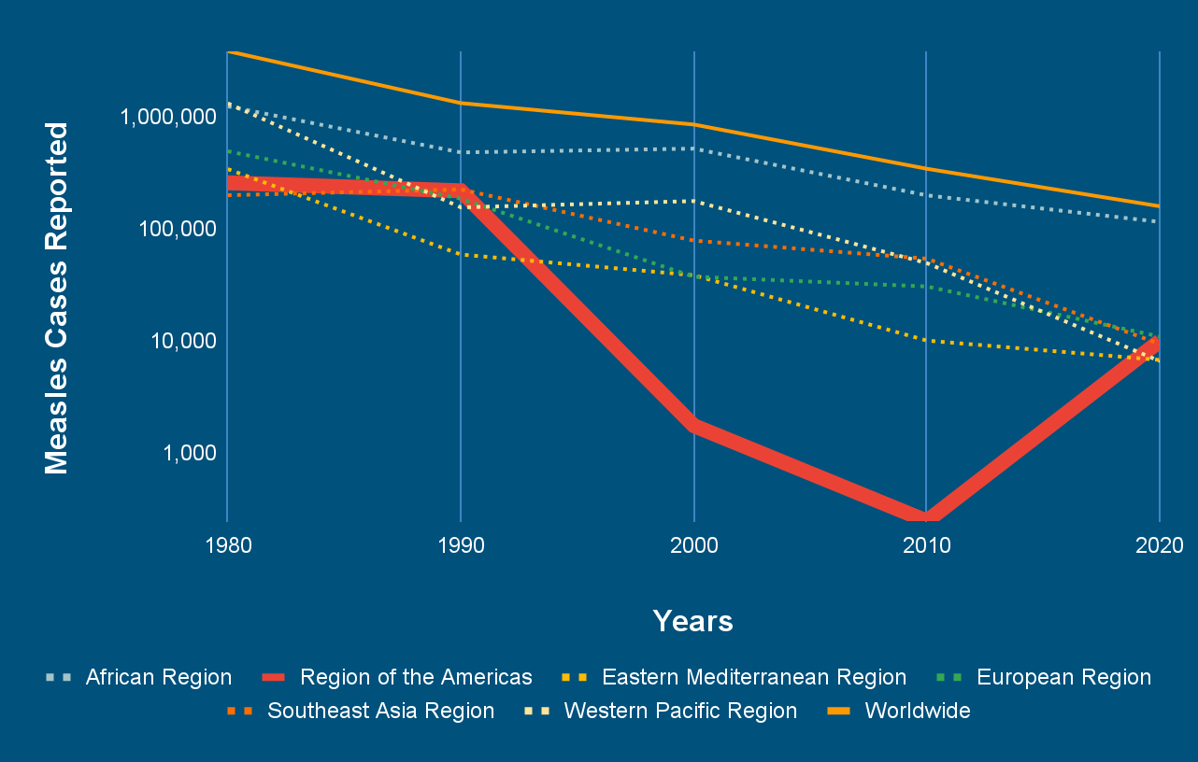
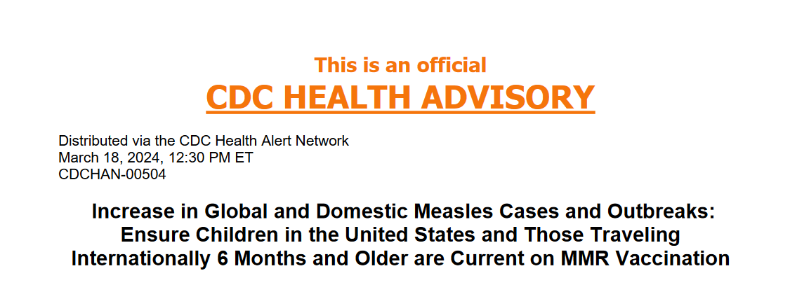
CDC releases Health Advisory
On March 18, CDC Health Advisory for vaccinating children.
Social media trends in anti-vaccine advocacy
Travel health alerts

Slide 6
Measles Overview Cont.
Others may have been exposed to measles at three health care locations where the child was taken for medical treatment. These locations include:
Acadian Urgent Care, 2117 Springwells, Detroit, April 1, noon–3 p.m.
Rite Health Pharmacy, 5851 West Vernor, Detroit, April 1, 1:45-4 p.m.
Children’s Hospital of Michigan Emergency Room, Beaubien Boulevard, Detroit, April 3,5–10 a.m.
According to the Detroit News, Michigan's fifth confirmed case of measles in 2024 was detected on Tuesday, April 9th. The city's Health Department said the case was recorded in a 4-year-old resident who had not received any doses of the measles vaccine and that the family of the child is following all isolation protocols.
Measles confirmed in Detroit 4-year-old, raising Michigan's total to 5 cases (detroitnews.com)

Slide 7
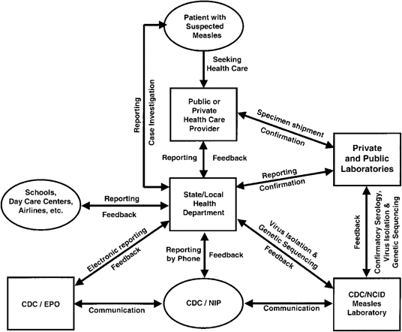
Measles Surveillance Systems
Surveillance in US can be traced back to 1912.
Coordinated between the state and federal agencies.
Involves coordination between multiple departments.
Still uses technologies like telephone calls and fax to report cases.
System as described in 2004

Slide 8
Role of Informatics in Measles Surveillance
Participatory Health Informatics( PHI): Use the information of measles as provided through the web, smartphones, or wearables to increase the participation of patients and health care professionals.
Geographic Information System(GIS):Utilize GIS to map and visualize disease outbreaks, vaccination coverage, and high-risk areas
Revamping current surveillance system: Updating and improving the methods used to monitor and track measles.
Predictive tools based social media trends and immunization rates: Utilize the data from the social media platforms and immunization records to forecast disease outbreaks and identify areas at risk.

Slide 9
Opportunities: New Research
New opportunities for research involve exploring innovative approaches to enhance measles surveillance.
Enhanced surveillance methods.
Integrated data sources for comprehensive insights.
Geographic mapping for hotspot identification.
Real-time monitoring systems for rapid response.
Technological education initiatives for healthcare workers and the public.
Digital communication strategies for measles awareness.
Interdisciplinary collaboration for innovative solutions.

Slide 10
Challenges: Measles Informatics
Incomplete and delayed reporting
Data Quality Issues
Limited Data Sharing and Integration
Resource Constraints
Privacy Concerns
Underreporting and Misdiagnosis
Global Coordination and Collaboration

Slide 11
Ethical and Legal Considerations
Ethical considerations for measles encompass
equitable vaccine access,
patient privacy in surveillance,
countering misinformation and hesitancy, and respecting cultural beliefs.
Legal obligations may include
mandatory vaccination,
case reporting, and
safeguarding personal health data.

Slide 12
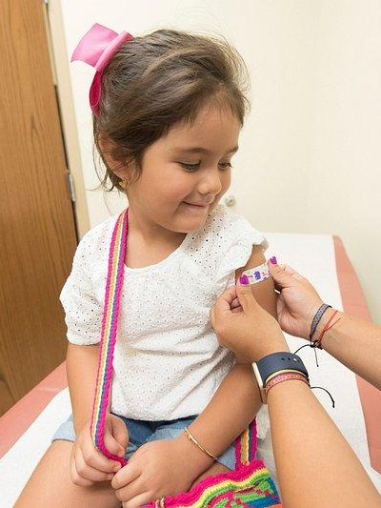
Conclusion: A Big Catch-Up
Measles resurgence over the past 4 years raises concerns over the health care infrastructure.
A major infectious disease from the 20th century has existing countermeasures.
Modernisation of the disease surveillance system.
Implementing PHI techniques from combating lowering immunization rates.
Effects of social media trends

Slide 13
References
David N Durrheim, Jon K Andrus, The ethical case for global measles eradication—justice and the Rule of Rescue, International Health, Volume 12, Issue 5, September 2020, Pages 375–377, https://doi.org/10.1093/inthealth/ihaa038
Gabarron, Elia et al. “Role of Participatory Health Informatics in Detecting and Managing Pandemics: Literature Review.” Yearbook of medical informatics vol. 30,1 (2021): 200-209. doi:10.1055/s-0041-1726486
Gastañaduy, Paul A et al. “Measles in the 21st Century: Progress Toward Achieving and Sustaining Elimination.” The Journal of infectious diseases vol. 224,12 Suppl 2 (2021): S420-S428. doi:10.1093/infdis/jiaa793
The Detroit News https://www.detroitnews.com/story/news/local/detroit-city/2024/04/10/officials-measles-confirmed-in-detroit-child-4/73277598007/
Global measles threat continues to grow as another year passes with millions of children unvaccinated : https://www.who.int/news/item/16-11-2023-global-measles-threat-continues-to-grow-as-another-year-passes-with-millions-of-children-unvaccinated
It's no surprise there's a global measles outbreak. But the numbers are 'staggering FEBRUARY 8, 20248:06 AM By Fran Kritz https://www.npr.org/sections/goatsandsoda/2024/02/08/1229540182/its-no-surprise-theres-a-global-measles-outbreak-but-the-numbers-are-staggering
U.S. Measles Cases Surpass 2023 Levels, C.D.C. Says There are several factors driving the spread of the highly infectious virus, experts said. https://www.nytimes.com/2024/03/22/well/live/measles-cases-united-states.html
Measles Surveillance in the United States: An Overview
Dalya Güris, Rafael Harpaz, Susan B. Redd, Natalie J. Smith Author Notes https://academic.oup.com/jid/article/189/Supplement_1/S177/822153
Measles — United States, January 1, 2020–March 28, 2024 Weekly / April 11, 2024 / 73(14);295–300 https://www.cdc.gov/mmwr/volumes/73/wr/mm7314a1.htm

